Slide 1
Revisiting BBS Signatures
Stefano Tessaro, Chenzhi Zhu
University of Washington
Notes:
I am going to talk about our work on BBS signatures

Slide 2
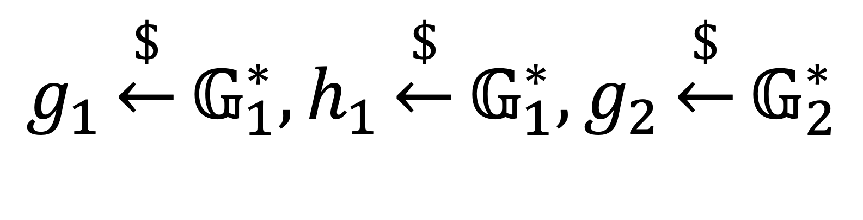
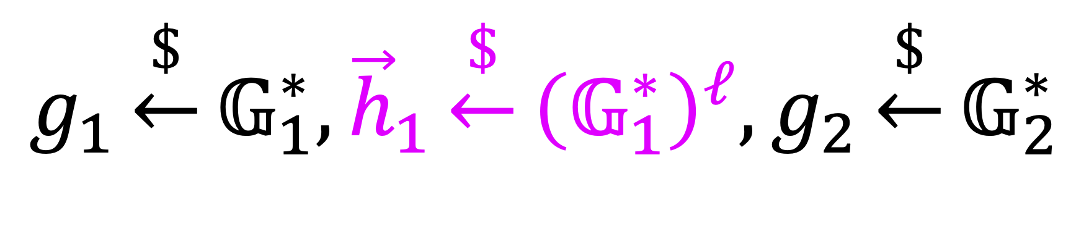
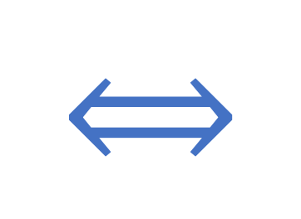
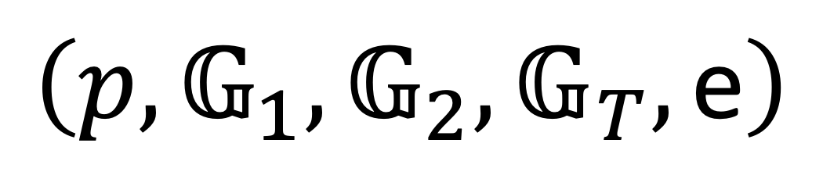
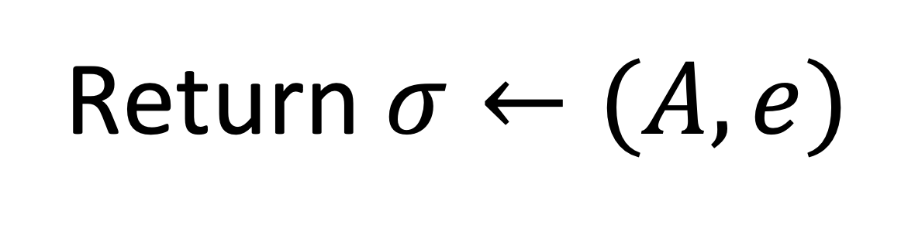
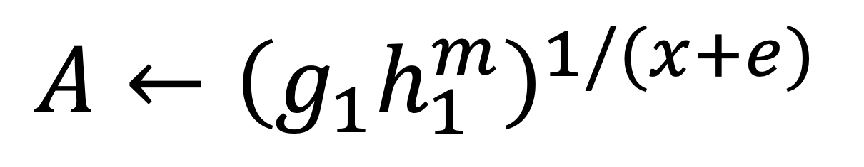
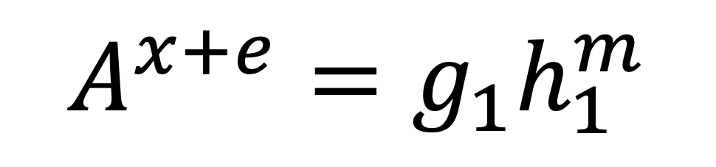
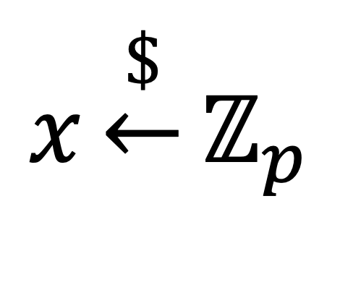
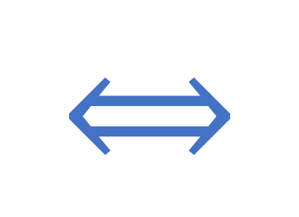
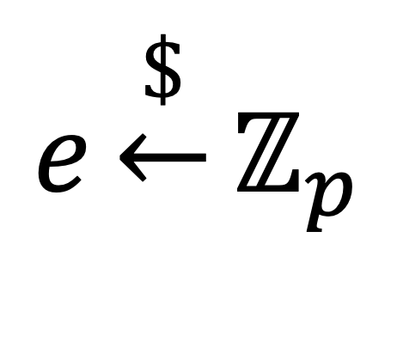
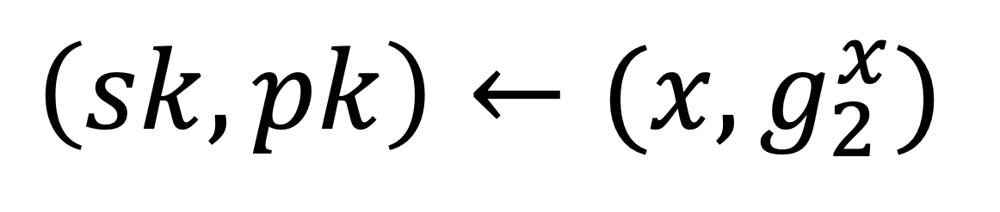
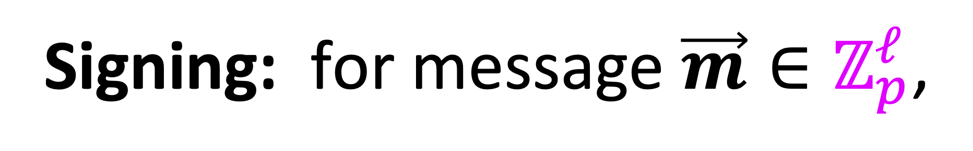
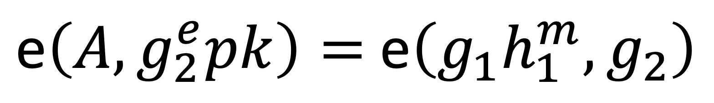
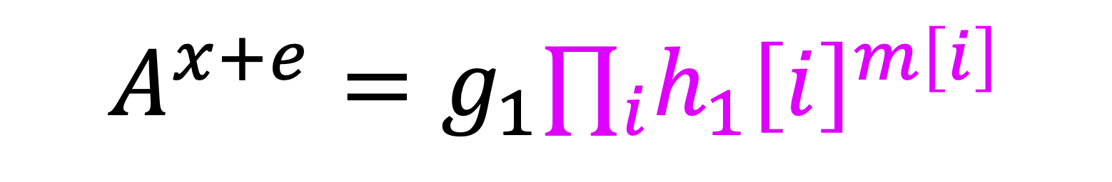
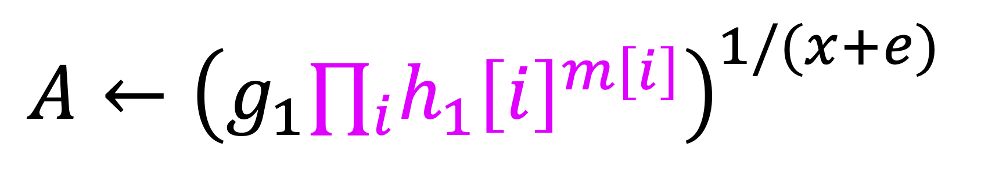
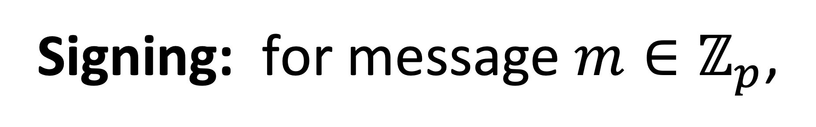
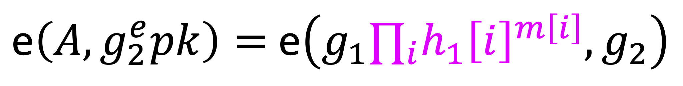
BBS Signatures [BBS04,CL04]
Not BBS group signatures
$$g_{1}\underset{←}{\$}𝔾_{1}^{∗},h_{1}\underset{←}{\$}𝔾_{1}^{∗},g_{2}\underset{←}{\$}𝔾_{2}^{∗}$$
Setup:
$$\left(p,𝔾_{1},𝔾_{2},𝔾_{T},\text{e}\right)$$
$$g_{1}\underset{←}{\$}𝔾_{1}^{∗},{\vec{h}}_{1}\underset{←}{\$}{\left(𝔾_{1}^{∗}\right)}^{ℓ},g_{2}\underset{←}{\$}𝔾_{2}^{∗}$$
$$x\underset{←}{\$}ℤ_{p}$$
Key Generation:
$$\left(sk, pk\right)←(x, g_{2}^{x})$$
Signing: for message $\vec{m}∈ℤ_{p}^{ℓ}$,
Signing: for message $m∈ℤ_{p}$,
$$e\underset{←}{\$}ℤ_{p}$$
$A←{\left(g_{1}∏_{i}h_{1}{\left[i\right]}^{m\left[i\right]}\right)}^{1/(x+e)}$
$A←{\left(g_{1}h_{1}^{m}\right)}^{1/(x+e)}$
Return $σ←(A,e)$
Verification: $σ=\left(A,e\right)$ is valid for $m$ if and only if
$$A^{x+e}=g_{1}∏_{i}h_{1}{\left[i\right]}^{m\left[i\right]}$$
$\text{e}\left(A, g_{2}^{e}pk\right)=$ $\text{e}\left(g_{1}∏_{i}h_{1}{\left[i\right]}^{m\left[i\right]},g_{2}\right)$
$$⟺$$
$$A^{x+e}=g_{1}h_{1}^{m}$$
$$⟺$$
$\text{e}\left(A, g_{2}^{e}pk\right)=$ $\text{e}\left(g_{1}h_{1}^{m},g_{2}\right)$
Support type-3 pairings (most efficient pairing-free curves, e.g. BLS12-381[Bow17])
Notes:
We can also extend the message to be a vector in Z_p.
Also, BBS can be instantiated from type-3 pairings which allow for the most efficient implementations, such as BLS12 curves.

Slide 3



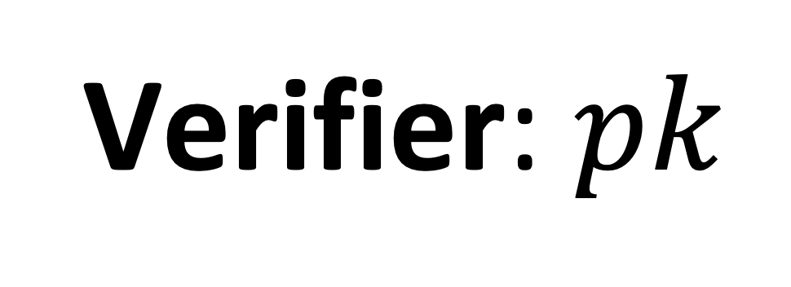
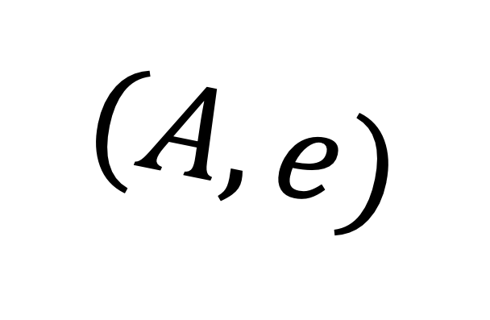
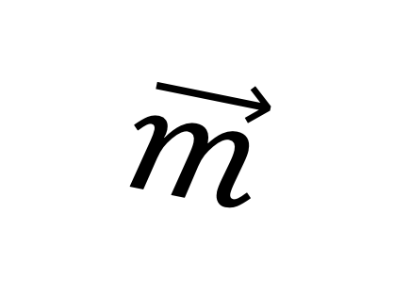
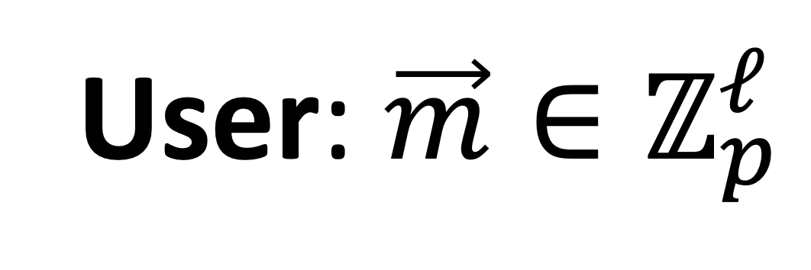
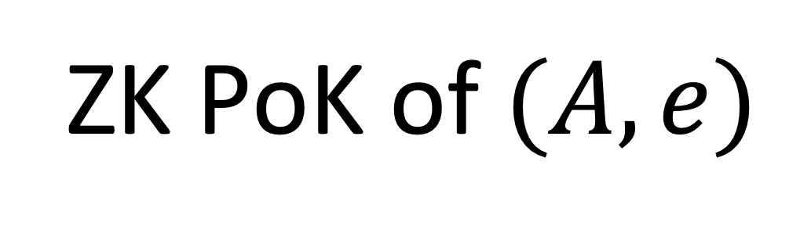
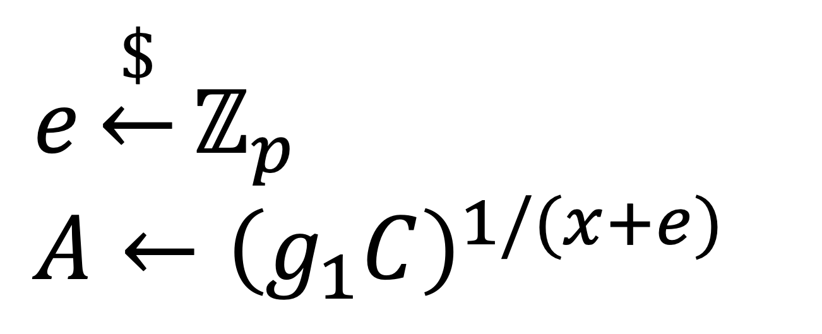

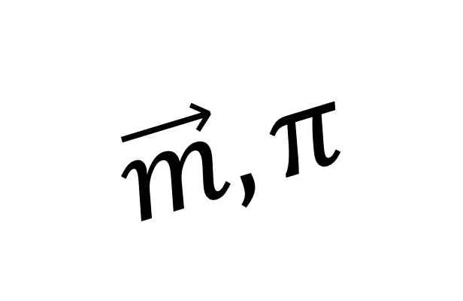
Application: Anonymous Credentials [CL04]
ZK PoK of $(A,e)$
$$\vec{m}$$
$$(A,e)$$
$$\vec{m}, π$$
Issuer:$sk=x$
Credential
Support partial showing
Verifier: $pk$
User: $\vec{m}∈ℤ_{p}^{ℓ}$
$$e\underset{←}{\$}ℤ_{p}$$
$A←{\left(g_{1}C\right)}^{1/(x+e)}$
Related application: Direct Anonymous Attestation (DAA) [BL10, CDL16]
Notes:
One significant application of BBS is in the construction of anonymous credential schemes. In such schemes, the user seek to obtain a credential for some attributes m from a trusted authority, referred to as the issuer, such that the credential can later be shown to others in an anonymous way.
BBS can be used a crendital
Later, when the user want to show the credential for the attributes but without revealing the credential, the user sends the attributes to the verifier together with a zero-knowledge proof of knowledge of the credential. The user can even reveal only certain parts of the attributes using zero-knowledge proof.
One related use case for BBS is the construction of Direct Anonymous Attestation schemes.

Slide 4
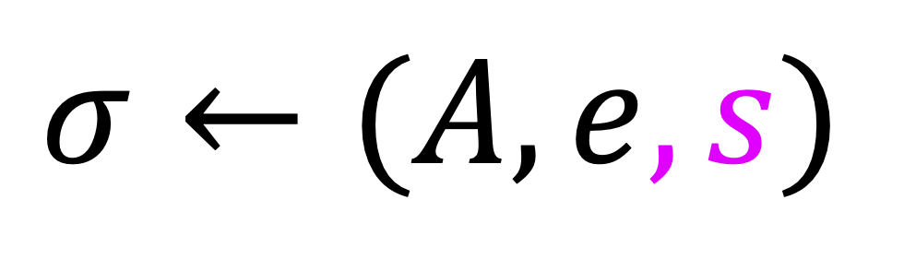
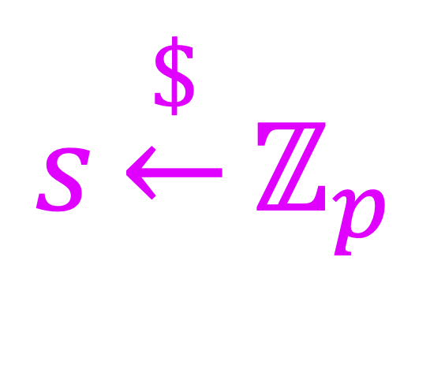
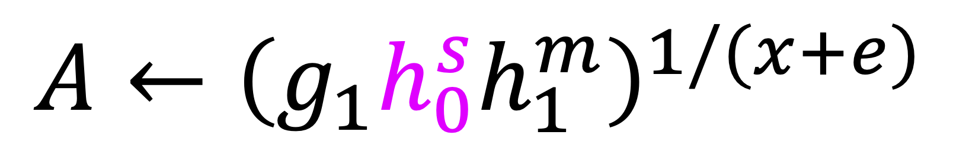
History of BBS Signatures
2004 – Derived from [BBS04], made explicit in [CL04]
no security proof
2006 – [ASM06] BBS+
provably secure w/ type-2 pairings
2010 – [BL10] build DAA from BBS
incorrect security proof would imply security of BBS
2016 – [CDL16] build DAA from BBS+
new security proof w/ type-3 pairings
2022 – W3C standardization and RFC draft [LKWL22] for BBS+
BBS+:
$$s\underset{←}{\$}ℤ_{p}$$
$A←{\left(g_{1}h_{0}^{s}h_{1}^{m}\right)}^{1/(x+e)}$
Question: Are BBS signatures provably secure?
$$σ←(A,e, s)$$
Notes:
The history of BBS signatures is a bit complicated
BBS signatures were implicitly proposed by Boneh, Boyen, and Shacham as part of their group signature scheme, and made explicit by Camenisch and Lysyanskaya in 2004, but without a security proof.
In 2006, a variant called BBS+ was proposed together with a security proof in the type-2 pairing setting. The difference between BBS+ and BBS lies in an additional value s sampled during signing, which contributes to an extra term when computing A and is added to the signature.
In 2010, a DAA scheme based on BBS was proposed, but its security proof turned out to be incorrect. If the proof were correct, it would imply security of BBS.
In 2016, a DAA scheme based on BBS+ was proposed, accompanied by a new security proof for BBS+ in the setting of type-3 pairings.
Also, quite recently, there are on-going standardization efforts for BBS+ by W3C and RFC.
After seeing this history, a natural question to ask is whether BBS signatures are provably secure.

Slide 5
Question: Are BBS signatures provably secure?
potential fix to [BL10] implies secure DAA from BBS
This work
Yes, BBS is as secure as BBS+, but more efficient!
Tight security in the Algebraic Group Model (AGM) [FKL18]
More efficient zero-knowledge PoK of message-signature pairs
Analysis of blind issuance of BBS signatures
On-going: RFC being adapted for BBS and our PoK !
Notes:
Our work provides an affirmative answer to this question. more precisely, we show that BBS is as secure as BBS+. Our security proof works for type-3 pairings and provides the same level of security as the prior proof. of BBS+. so BBS is just more efficient.
In addition, our work also gives potential fix to the prior incorrect proof, which implies a secure DAA scheme from BBS.
Furthermore, we accompany our standard model proof with a tight AGM proof, enabling more efficient parameter settings for practical uses of BBS.
We also introduce a more efficient proof of knowledge protocol for BBS.
Lastly, we analyze the blind issuance of BBS signatures.
I would also like to highlight that there is an ongoing effort to adapt the RFC draft for BBS and our PoK protocol.

Slide 6
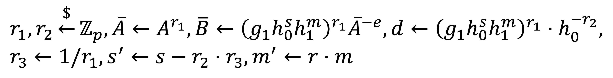
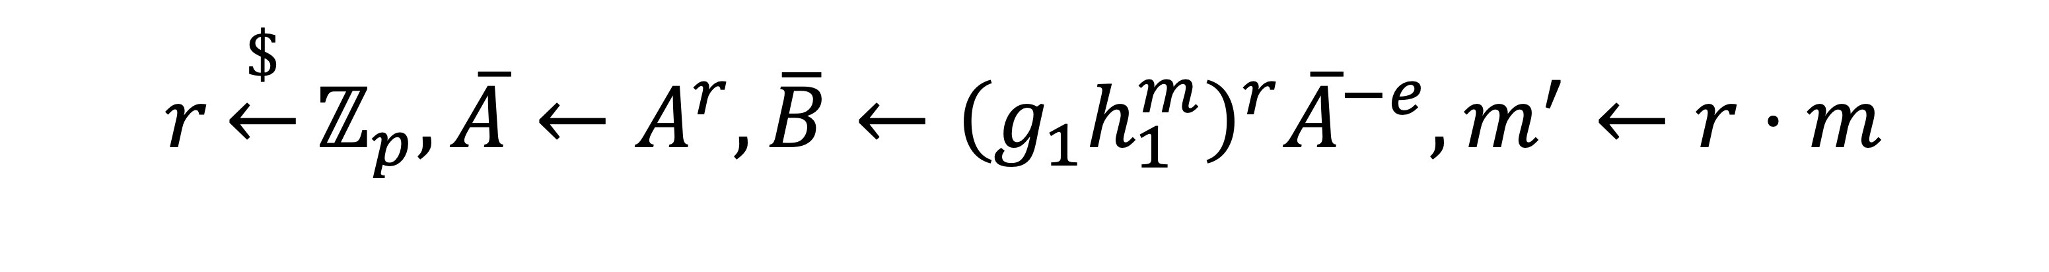
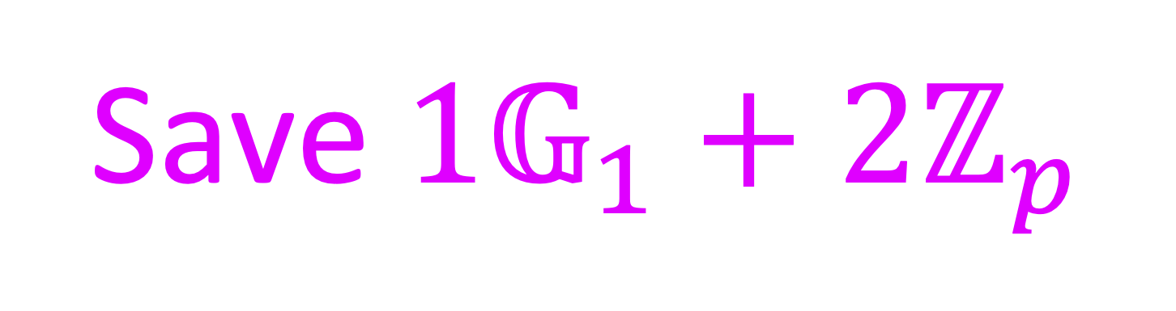
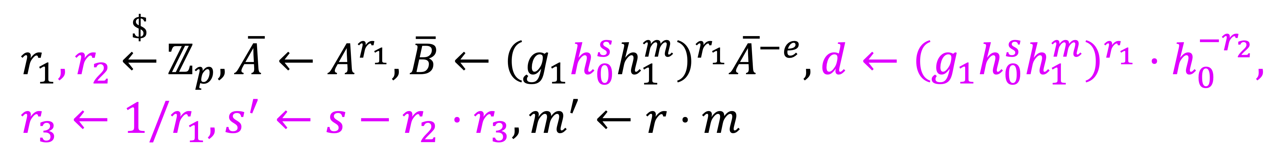
Better ZK PoK of signatures
[CDL16, LKWL22]
$$r_{1},r_{2}\underset{←}{\$}ℤ_{p}, \overline{A}←A^{r_{1}},\overline{B}←{\left(g_{1}h_{0}^{s}h_{1}^{m}\right)}^{r_{1}}{\overline{A}}^{−e},d←{\left(g_{1}h_{0}^{s}h_{1}^{m}\right)}^{r_{1}}⋅h_{0}^{−r_{2}}, r_{3}←1/r_{1},s^{′}←s−r_{2}⋅r_{3},m^{′}←r⋅m$$
$$r_{1},r_{2}\underset{←}{\$}ℤ_{p}, \overline{A}←A^{r_{1}},\overline{B}←{\left(g_{1}h_{0}^{s}h_{1}^{m}\right)}^{r_{1}}{\overline{A}}^{−e},d←{\left(g_{1}h_{0}^{s}h_{1}^{m}\right)}^{r_{1}}⋅h_{0}^{−r_{2}}, r_{3}←1/r_{1},s^{′}←s−r_{2}⋅r_{3},m^{′}←r⋅m$$
Return $π←\left(\overline{A},\overline{B},d,SPK\left(\left(e,r_{2},r_{3},s^{′},m^{′}\right):\overline{B}=d{\overline{A}}^{−e}h_{0}^{r_{2}}∧d^{r_{3}}=g_{1}h_{0}^{s′}h_{1}^{m′}\right)\right)$
Return $π←\left(\overline{A},\overline{B},d,SPK\left(\left(e,r_{2},r_{3},s^{′},m^{′}\right):\overline{B}=d{\overline{A}}^{−e}h_{0}^{r_{2}}∧d^{r_{3}}=g_{1}h_{0}^{s′}h_{1}^{m′}\right)\right)$
[This work]
Save $1𝔾_{1}+2ℤ_{p}$
$$r\underset{←}{\$}ℤ_{p}, \overline{A}←A^{r},\overline{B}←{\left(g_{1}h_{1}^{m}\right)}^{r}{\overline{A}}^{−e},m^{′}←r⋅m$$
Save 893 bits with BLS12-381
Return $π←\left(\overline{A},\overline{B},SPK\left(\left(e,r,m^{′}\right):\overline{B}=g_{1}^{r}h_{1}^{m′}{\overline{A}}^{−e}\right)\right)$
Notes:
Before we dive into the technical parts, let me give an overview of the improvements we have made to the PoK protocol.
Here is the most efficient PoK of BBS+ prior to our work, which was adopted by the RFC draft.
And here is ours.
Concretely, it saves 1 group element and 2 scalars in the size of proof. If implemented using BLS12-381, the total reduction in size is 900 bits.

Slide 7
For the rest of the talk
How to prove BBS secure?
Notes:
For the rest of the talk, I will focus on how to prove BBS secure.

Slide 8
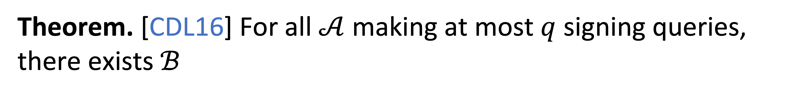
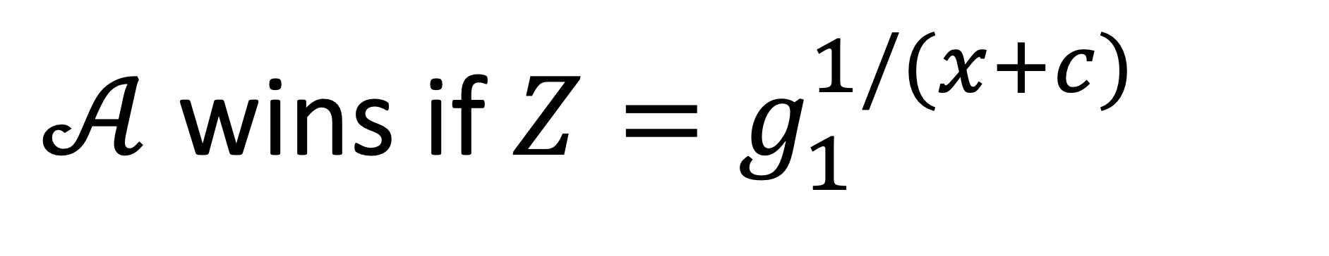
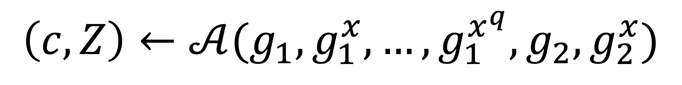
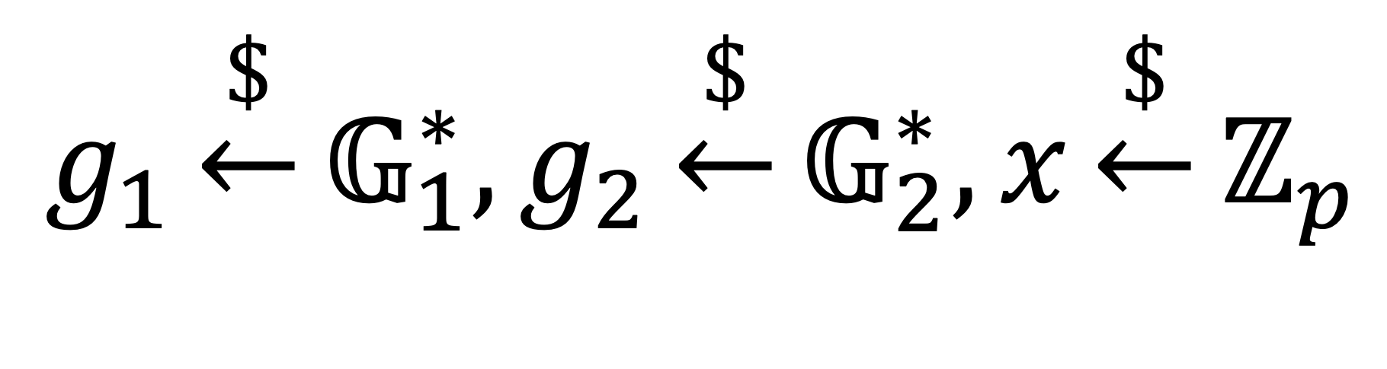
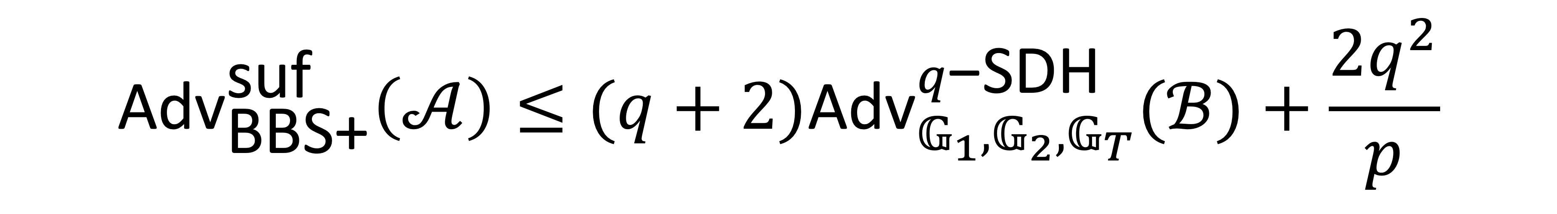
Theorem. [CDL16] For all $𝒜$ making at most $q$ signing queries, there exists $ℬ$
$${\text{A}\text{dv}}_{\text{BBS}\text{+}}^{\text{suf}}\left(𝒜\right)≤(q+2){\text{Adv}}_{𝔾_{1},𝔾_{2},𝔾_{T}}^{q\text{−}\text{SDH}}(ℬ)+\frac{2q^{2}}{p}$$
q-SDH Assumption [BB08]
Strong Unforgeability
$$g_{1}\underset{←}{\$}𝔾_{1}^{∗},g_{2}\underset{←}{\$}𝔾_{2}^{∗},x\underset{←}{\$}ℤ_{p}$$
Hard to forge a new message-signature pair
$$\left(c, Z\right)←𝒜(g_{1},g_{1}^{x},…, g_{1}^{x^{q}},g_{2},g_{2}^{x})$$
$𝒜$ wins if $Z=g_{1}^{1/(x+c)}$
Notes:
Here is the prior theorem for the security of BBS+, which shows BBS+ is strong unforgeable by reducing it to the q strong Diffie–Hellman assumption, where q denotes the number of singing queries.
The assumption is defined by the following game, in which a generator g1, g2 and a challenge are initially sampled. Then, the adversary is then given g1, g1 to x, g1 to x squared, and so on up to g1 to the power of x to q, along with g2 and g2 to x. The adversary's objective is to output c and Z such that Z is equal to g1 to the power of 1/(x+c).

Slide 9
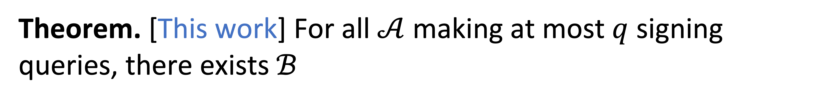
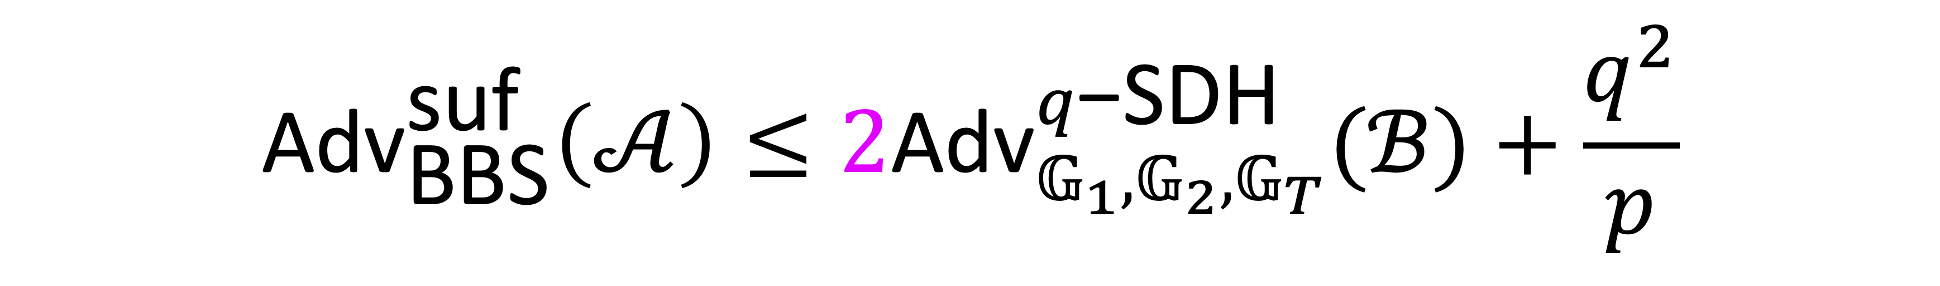
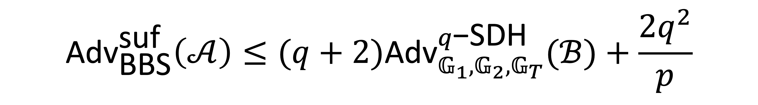
Theorem. [This work] For all $𝒜$ making at most $q$ signing queries, there exists $ℬ$
$${\text{A}\text{dv}}_{\text{BBS}}^{\text{suf}}\left(𝒜\right)≤(q+2){\text{Adv}}_{𝔾_{1},𝔾_{2},𝔾_{T}}^{q\text{−}\text{SDH}}(ℬ)+\frac{2q^{2}}{p}$$
Tight bound in AGM
$${\text{A}\text{dv}}_{\text{BBS}}^{\text{suf}}\left(𝒜\right)≤2{\text{Adv}}_{𝔾_{1},𝔾_{2},𝔾_{T}}^{q\text{−}\text{SDH}}(ℬ)+\frac{q^{2}}{p}$$
Notes:
In this work, we prove the exactly same theorem but for BBS.
Also, we prove a tight bound in the algebraic group model. However, I will focus on the proof in the standard model in this talk.

Slide 10
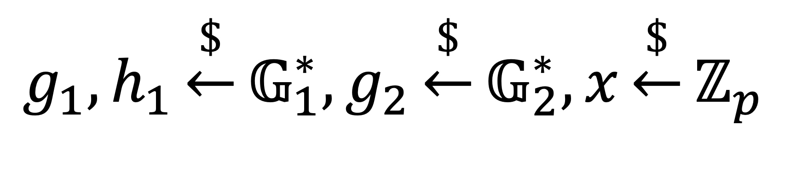
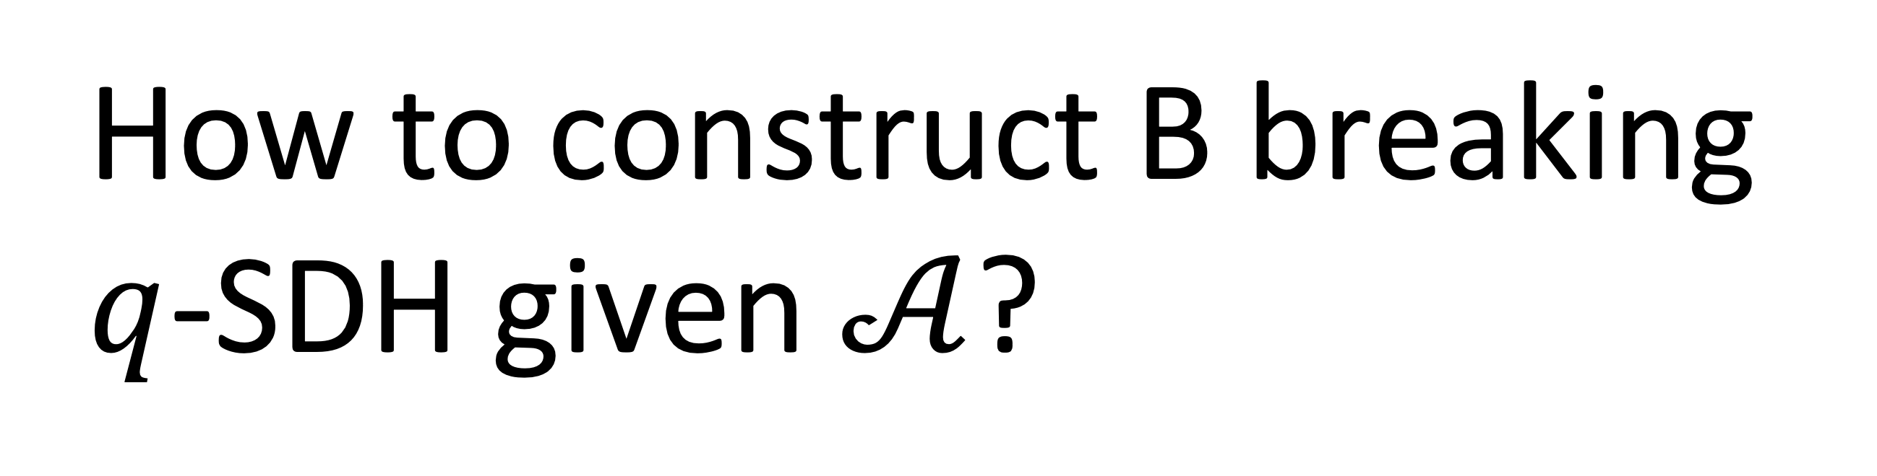


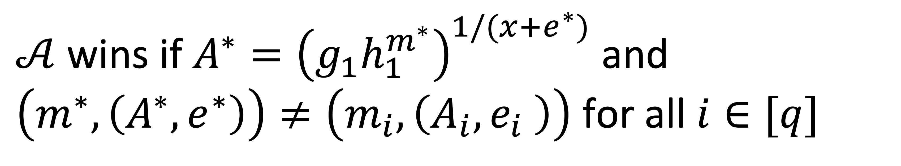
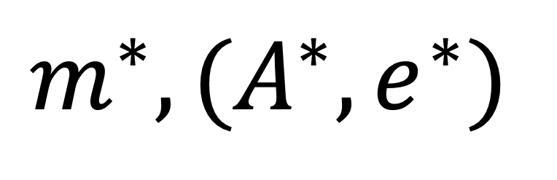
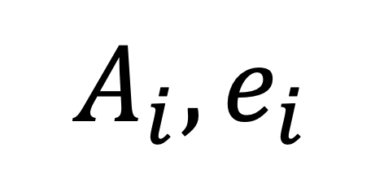
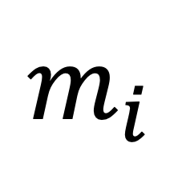
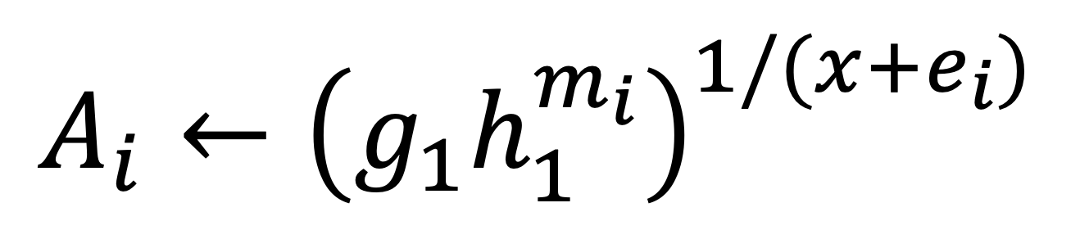
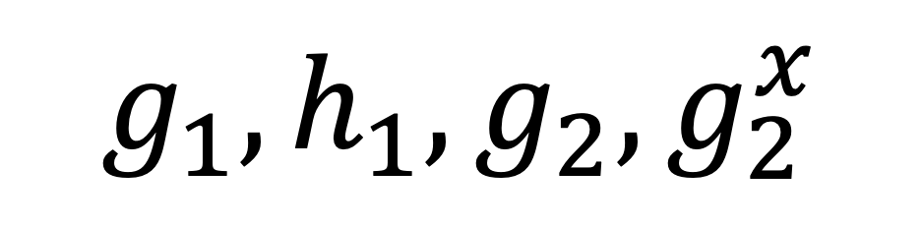
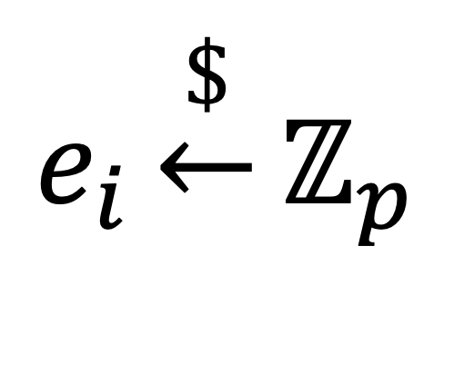
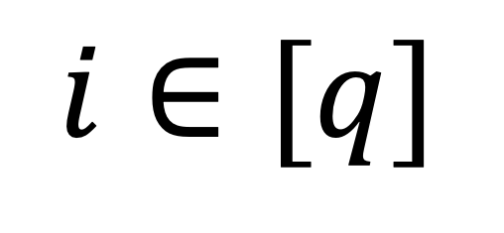
Strong unforgeability game of BBS
$$g_{1},h_{1},g_{2},g_{2}^{x}$$
$$g_{1},h_{1}\underset{←}{\$}𝔾_{1}^{∗},g_{2}\underset{←}{\$}𝔾_{2}^{∗},x\underset{←}{\$}ℤ_{p}$$
$$𝒜$$
For the $i$-th signing query,
$$i∈[q]$$
$$m_{i}$$
$$e_{i}\underset{←}{\$}ℤ_{p}$$
Sign
$$A_{i},e_{i}$$
How to construct B breaking $q$-SDH given $𝒜$?
$A_{i}←{\left(g_{1}h_{1}^{m_{i}}\right)}^{1/(x+e_{i})}$
$$m^{∗},(A^{∗},e^{∗})$$
$𝒜$ wins if $A^{∗}={\left(g_{1}h_{1}^{m^{∗}}\right)}^{1/(x+e^{∗})}$ and $\left(m^{∗},\left(A^{∗},e^{∗}\right)\right)≠\left(m_{i},\left(A_{i},e_{i} \right)\right)$ for all $i∈[q]$
Notes:
First, let's recall the strong unforgeability game. The challenger begins by generating all the required generators and a secret key x, and sends all the generators and the corresponding public key to the adversary. The adversary has access to a signing oracle, which generates a signature for any given message. Each signing query is indexed by i, with i is bounded by q. The adversary's objective is to output a message-signature pair that is valid and distinct from all those generated by the signing oracle.
Now, we turn our attention to the task of constructing B that breaks q-SDH.

Slide 11
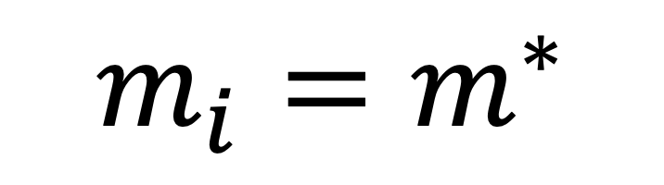









How to construct B breaking $q$-SDH given $𝒜$?
Observation. If $𝒜$ wins, there are 3 cases:
(1) $e^{∗}∉\{e_{1},…,e_{q}\}$
(2) $∃i∈\left[q\right]$ such that $e_{i}=e^{∗}$ but $A_{i}≠A^{∗}$
(3) $∃i∈\left[q\right]$ such that $e_{i}=e^{∗}$ and $A_{i}=A^{∗}$
(1) and (3) are easy using similar ideas for BBS+ [ASM06, CDL16]
(2) Most challenging
$⟹$ New technique!
For case (3), it is easy to see it never occurs
$$g_{1}h_{1}^{m_{i}}=g_{1}h_{1}^{m^{∗}}$$
${\left(g_{1}h_{1}^{m_{i}}\right)}^{1/(x+e_{i})}=A_{i}=A^{∗}=$ ${\left(g_{1}h_{1}^{m^{∗}}\right)}^{1/(x+e^{∗})}$
$$⟹$$
$$⟹$$
$$m_{i}=m^{∗}$$
In general, $\vec{m}∈ℤ_{p}^{ℓ}$ is a vector: break binding property of Pedersen commitment
Contradiction: $𝒜$ does not win
Notes:
We can observe that if A wins, then there are three possible cases:
The first case is when e* differs from all the e values generated by the oracle.
The second case is when e* is equal to one of e_i, but A* is not equal to A_i.
Finally, if the above two cases do not occur, then there must exists an index i such that (A*,e*) = (A_i, e_i).
Case 1 and case 3 can be handled using prior techniques , while case 2 poses the greatest challenge, and we have developed a new technique to address it. In the following discussion, I will delve into each of these cases in detail.
First, for case (3), it is easy to see it never occurs since it implies g_1h_1^m_i = g_1 h_1^m*, which implies m_i is equal to m*. This contradicts with the winning condition of A.
We also note that case (3) can occur when m is a vector in Z_p, but then it breaks the binding property of Pedersen commitment.

Slide 12




















For case (1), we construct $ℬ$ for $q$-SDH as follows
$$g_{1},g_{1}^{x},…,g_{1}^{x^{q}},g_{2},g_{2}^{x}$$
Assume w.l.o.g. all $e_{1},…,e_{q}$ are distinct
$$ℬ$$
$$e_{1},…,e_{q}\underset{←}{\$}ℤ_{p}$$
$$p\left(\text{X}\right)≔∏_{i}(\text{X}+e_{i})$$
$$θ,α\underset{←}{\$}ℤ_{p}$$
$ℬ$ can compute ${\overline{g}}_{1}$, since $\deg\left(p\right)=q$
$${\overline{g}}_{1},h_{1},g_{2},g_{2}^{x}$$
${\overline{g}}_{1}←g_{1}^{θ⋅p(x)}, h_{1}←{\overline{g}}_{1}^{α}$,
$$𝒜$$
$$m_{i}$$
Since $\left(\text{X}+e_{i}\right)$ divides $p\left(\text{X}\right)$, $ℬ$ can compute $A_{i}$
$$A_{i}←{\left({\overline{g}}_{1}h_{1}^{m_{i}}\right)}^{1/(x+e_{i})}$$
This method does not work for case (2), since $e^{∗}=e_{i}$ for some $i$
$$A_{i},e_{i}$$
Sign
$$=g_{1}^{\left(θ+αm_{i}\right)p(x)/(x+e_{i})}$$
$$m^{∗},(A^{∗},e^{∗})$$
$p\left(\text{X}\right)$ not divisible by $\left(\text{X}+e^{∗}\right)$ since $e^{∗}∉\{e_{1},…,e_{q}\}$
$$A^{∗}=g_{1}^{\left(θ+αm^{∗}\right)p(x)/(x+e^{∗})}$$
[BB04]
compute $\left(e^{∗}, g_{1}^{\frac{1}{x+e^{∗}}}\right)$
$$⟹$$
Notes:
For case (1), we construct B as follows.
B begins by sampling all the e values that are used in answering signing queries. W.l.o.g. we assume all e values are distinct. We also denote a polynomial p as the product of (X + e_i).
Then, B runs A with the generators g1-bar and h1, which are generated as follows, where theta and alpha are randomization factors.
Note that since the degree of p is q, g_1-bar can be computed from B’s input.
Then, to simulate the i-th signing oracle, B needs to computes A_i which is defined as follows. It is easy to see B can efficiently compute A_i since p is divisible by (X + e_i).
Finally, if A wins, we have the following equation holds. Since case (1) occurs, we know p is not divisible by (X+e*) since e* differs from all the e values generated by B. Then, using a classical technique due to Boneh and Boyen, B can compute g_1 to the power of 1/(x+e*) and thus win the q-SDH game.
However, this method does not work for case (2) since e* = ei for some i.

Slide 13
















For case (2), how [ASM06, CDL16] handle it for BBS+?
$$g_{1},g_{1}^{x},…,g_{1}^{x^{q}},g_{2},g_{2}^{x}$$
$$p\left(\text{X}\right)/(\text{X}+e_{i^{∗}})$$
$$ℬ$$
$$i^{∗}\underset{←}{\$}[q]$$
$$e_{1},…,e_{q}\underset{←}{\$}ℤ_{p}$$
$$=$$
$$p′\left(\text{X}\right)≔∏_{i≠i^{∗}}(\text{X}+e_{i})$$
$$θ,α,δ,β\underset{←}{\$}ℤ_{p}$$
$$g_{1},h_{0},h_{1},g_{2},g_{2}^{x}$$
$${\overline{g}}_{1}←g_{1}^{θ⋅p′(x)}, h_{0}←{{\overline{g}}_{1}}^{\frac{δ\left(x+e_{i^{∗}}\right)−1}{α}},h_{1}←h_{0}^{β}$$
$$𝒜$$
For ${i≠i}^{∗},$ similar to case (1)
$$m_{i}$$
$s_{i}$ $\underset{←}{\$}ℤ_{p}$
$\left(\text{X}+e_{i}\right)$ divides $p^{′}\left(\text{X}\right)$
$$A_{i},{s_{i,}e}_{i}$$
Sign
$$A_{i}←{\left({\overline{g}}_{1}h_{0}^{s_{i}}h_{1}^{m_{i}}\right)}^{1/(x+e_{i})}$$
How about the $i^{∗}$-th query?
Notes:
Before discussing our solution, let’s first review on how prior works address the issue for BBS+?
The idea is to guess the index i* such that e_i* collides with e* and then simulate the i*-th query differently.
Since the reduction is a bit complicated, I will not delve into the computational details here, but only highlight a few key points.
Here we define a new polynomial p’, which is exactly equal to p divided by (X+e_{i*}). Next, B generates g_1-bar using p', as in case 1. This enables B to simulate the i-th signing query for all i not equal to i*, similar way to case 1.
Now, let's consider how to handle the i*-th query.

Slide 14










How about the $i^{∗}$-th query?
$${\overline{g}}_{1}←g_{1}^{θ⋅p′(x)}, h_{0}←{{\overline{g}}_{1}}^{\frac{δ\left(x+e_{i^{∗}}\right)−1}{α}},h_{1}←h_{0}^{β}$$
$$m_{i^{∗}}$$
$$𝒜$$
Sign
$$A_{i^{∗}},{s_{i^{∗},}e}_{i^{∗}}$$
$$A_{i^{∗}}←{\left({\overline{g}}_{1}{h_{0}^{s_{i^{∗}}}h}_{1}^{m_{i^{∗}}}\right)}^{1/(x+e_{i^{∗}})}$$
cancel out
$$=$$
$$g_{1}^{\frac{θ}{α}⋅p^{′}\left(x\right)\left(δ\left(βm_{i^{∗}}+s_{i^{∗}}\right)\left(x+e_{i^{∗}}\right)+α−\left(βm_{i^{∗}}+s_{i^{∗}}\right)\right)/(x+e_{i^{∗}})}$$
$A_{i^{∗}}$ computable if $α−\left(βm_{i^{∗}}+s_{i^{∗}}\right)=0$
Thus, $ℬ$ sets $s_{i^{∗}}←α−βm_{i^{∗}}$
Notes:
To start, let’s try to represent A_{i*} in base g_1. Given how the generators are computed, we have Ai* is equal to the following. It then becomes apparent that if the highlighted part is zero, then the (x+e_{i*}) terms cancel each other, which means B can compute A_{i*} efficiently.
Based on this observation, B sets s_{i*} to alpha minus beta times m_{i}. It's worth noting that s_{i*} has the correct distribution due to the randomness of alpha.

Slide 15








For case (2), how [ASM06, CDL16] handle it for BBS+?
$$g_{1},g_{1}^{x},…,g_{1}^{x^{q}},g_{2},g_{2}^{x}$$
$$ℬ$$
$$i^{∗}\underset{←}{\$}[q]$$
$$e_{1},…,e_{q}\underset{←}{\$}ℤ_{p}$$
$$p′\left(\text{X}\right)≔∏_{i≠i^{∗}}(\text{X}+e_{i})$$
$$θ,α,δ,β\underset{←}{\$}ℤ_{p}$$
$$g_{1},h_{0},h_{1},g_{2},g_{2}^{x}$$
$${\overline{g}}_{1}←g_{1}^{θ⋅p′(x)}, h_{0}←{{\overline{g}}_{1}}^{\frac{δ\left(x+e_{i^{∗}}\right)−1}{α}},h_{1}←h_{0}^{β}$$
$$𝒜$$
$$m_{i}$$
$$A_{i},{s_{i,}e}_{i}$$
Sign
How does $ℬ$ extract a valid output for $q$-SDH?
$$m^{∗},(A^{∗},s^{∗},e^{∗})$$
Notes:
It is left to see how B extracts a valid output.

Slide 16








How does $ℬ$ extract a valid output for $q$-SDH?
Suppose case (2) occurs and $e^{∗}=e_{i^{∗}}$
$$A^{∗}={\left({\overline{g}}_{1}{h_{0}^{s^{∗}}h}_{1}^{m^{∗}}\right)}^{1/(x+e^{∗})}=g_{1}^{\frac{θ}{α}⋅p^{′}\left(x\right)\left(δ\left(βm^{∗}+s^{∗}\right)\left(x+e^{∗}\right)+α−\left(βm^{∗}+s^{∗}\right)\right)/(x+e^{∗})}$$
Since $e^{∗}=e_{i^{∗}}$ and $A^{∗}≠A_{i^{∗}}$, we have ${h_{0}^{s^{∗}}h}_{1}^{m^{∗}}≠h_{0}^{s_{i^{∗}}}h_{1}^{m_{i^{∗}}}$
$$⟹$$
$$h_{1}=h_{0}^{β}$$
$α−\left(βm_{i^{∗}}+s_{i^{∗}}\right)=0$
$$βm^{∗}+s^{∗}≠βm_{i^{∗}}+s_{i^{∗}}$$
Therefore, $α−\left(βm^{∗}+s^{∗}\right)≠0$
, which implies is not divisible by $(\text{X}+e^{∗})$
Thus, $ℬ can$compute $\left(e^{∗}, g_{1}^{\frac{1}{x+e^{∗}}}\right)$
Notes:
Suppose case (2) occurs and B makes a correct guess, i.e. e* = e_i*.
We can represent A* in base g_1 and we want to show that the highlighted part is not zero. This is because we have e* = e_i* but A* is not equal to A_i* which implies the following inequality, which implies beta m* +s* is not equal to beta mi* +si*.
Since alpha – beta m_{i*} + s_{i*} = 0, the highlighted part cannot be zero.
Therefore, the polynomial in the blue box is not divisible by (X+e*). Thus, B can win the game using the technique mentioned in case 1.

Slide 17



How to get rid of $s_{i}$?
In the previous proof, the role of $s_{i^{∗}}$ is critical:
$s_{i^{∗}}$ ensures $α−\left(βm_{i^{∗}}+s_{i^{∗}}\right)=0$ for any $m_{i^{∗}}$ chosen by $𝒜$
Our idea: Let $e_{i^{∗}}$ play the role of $s_{i^{∗}}$!
$e_{i^{∗}}$ does not need to be determined at the beginning
Notes:
We are now ready to explain our idea to get rid of the si. In the previous proof, the role of s_{i*} is critical because it ensures that the highlighted part is equals zero no matter which mi* is chosen by the adversary.
Our idea is to let ei* play the role of si*. Note that ei* does not need to be determined at the beginning.

Slide 18












Our proof for case (2)
$$g_{1},g_{1}^{x},…,g_{1}^{x^{q}},g_{2},g_{2}^{x}$$
$$ℬ$$
$$e_{1},…e_{i^{∗}−1},ε,e_{i^{∗}+1},e_{q}\underset{←}{\$}ℤ_{p}$$
$$i^{∗}\underset{←}{\$}[q]$$
$$p′\left(\text{X}\right)≔∏_{i≠i^{∗}}(\text{X}+e_{i})$$
$$θ,α\underset{←}{\$}ℤ_{p}$$
$$g_{1},h_{1},g_{2},g_{2}^{x}$$
$${\overline{g}}_{1}←g_{1}^{θ⋅p^{′}\left(x\right)⋅(x+ε)}, h_{1}←g_{1}^{α⋅p′(x)}$$
$$𝒜$$
For ${i≠i}^{∗},$ similar to case (1)
$$m_{i}$$
How to simulate the $i^{∗}$-th query ?
$$A_{i},e_{i}$$
Sign
$$m^{∗},(A^{∗},e^{∗})$$
How to extract a valid output for $q$-SDH?
Notes:
More precisely, in our reduction, B does not sample e_i* at the beginning but sample a randomization factor epsilon instead. Then, B sets g1 bar to be g1 raised to the power of theta p’ times (x+\epsilon) and set h1 to be g1 raised to the power of alpha p’.
Similarly to prior discussion, it is easy to see B can simulate all the queries except the i*-th one. The remaining questions are: first, how to simulate the i*-th query, and second, how to extract a valid output for q-SDH.

Slide 19






How about the $i^{∗}$-th query?
$$m_{i^{∗}}$$
$${\overline{g}}_{1}←g_{1}^{θ⋅p^{′}\left(x\right)⋅(x+ε_{i^{∗}})}, h_{1}←g_{1}^{α⋅p′(x)}$$
$$𝒜$$
Sign
$$A_{i^{∗}},e_{i^{∗}}$$
$$A_{i^{∗}}←{\left({\overline{g}}_{1}h_{1}^{m_{i^{∗}}}\right)}^{1/(x+e_{i^{∗}})}$$
cancel out
$$=$$
$$g_{1}^{{θ⋅p}^{′}\left(x\right)\left(x+ε+\frac{α}{θ} m_{i^{∗}}\right)/(x+e_{i^{∗}})}$$
Thus, $ℬ$ sets $e_{i^{∗}}=ε+\frac{α}{θ}m_{i^{∗}}$
$e_{i^{∗}}$ uniformly random due to $ε$
Notes:
To answer the first question, let’s represent A_i* in base g1. Then, it is clear that if B sets e_i* to epilson + alpha/theta * mi*, then the last two terms cancel out, and thus A_i* can be computed efficiently. Also, ei* is uniformly random due to the randomness of epsilon.

Slide 20





How to extract a valid output for $q$-SDH from $m^{∗},(A^{∗},e^{∗})$?
Suppose case (2) occurs and $e^{∗}=e_{i^{∗}}$
$$A^{∗}={\left({\overline{g}}_{1}h_{1}^{m^{∗}}\right)}^{1/(x+e^{∗})}=g_{1}^{{θ⋅p}^{′}\left(x\right)\left(x+ε+\frac{α}{θ}{ m}^{∗}\right)/(x+e^{∗}))}$$
Since $e^{∗}=e_{i^{∗}}$ and $A^{∗}≠A_{i^{∗}}$, we have $m^{∗}≠m_{i^{∗}}$
$$A_{i^{∗}}={\left({\overline{g}}_{1}h_{1}^{m_{i}∗ }\right)}^{1/(x+e_{i^{∗}})}$$
$$e_{i^{∗}}=ε+\frac{α}{θ}m_{i^{∗}}$$
Therefore, $ε+\frac{α}{θ}m^{∗}≠e_{i^{∗}}=e^{∗}$
, which implies is not divisible by $(\text{X}+e^{∗})$
Thus, $ℬ can$compute $\left(e^{∗}, g_{1}^{\frac{1}{x+e^{∗}}}\right)$
Notes:
For the second question, suppose that case 2 occurs and e* = ei*.
Let’s represent A* in base g_1, and we want to show the highlighted part is not equal to e*.
Since e* = e_i* and A* \neq A_i, it follows that m* is not equal to mi*.
Then, since ei* = \espilon + alpha/theta * mi*, we have the highlighted part cannot be ei*.
Therefore, the polynomial in the blue box is not divisible by (X + e*), and B can win the game.

Slide 21






Also in the paper – Blind Issuance
$$C$$
$$(A,e)$$
[This work] Security analysis in AGM
Issuer:$sk=x$
User: $\vec{m}∈ℤ_{p}^{ℓ}$
$$e\underset{←}{\$}ℤ_{p}$$
$A←{\left(g_{1}C\right)}^{1/(x+e)}$
$$C←∏_{i}h_{1}{\left[i\right]}^{m\left[i\right]}$$
Security: (one-more unforeability) hard to forge one-more signatures
Notes:
Finally, I want to briefly mention our analysis of blind issuance of BBS.
The protocol works as follows. The user first sends a Pedersen commitment of the message to the issuer and receives the corresponding BBS signature in return.
Our security objective here is to achieve one-more unforgeability, which guarantees that the adversary cannot produce more valid signatures than the number of signing requests. In this work, we show the presented scheme a chieves one-more unforgeability in the algebraic group model.

Slide 22
Conclusions
BBS is as provably secure as BBS+
But more efficient, no reason to use BBS+
Open question: Efficiency improvements in applications of BBS+, e.g., threshold signing?
Notes:
In conclusion, the main takeaway is that BBS is as provably secure as BBS+, but more efficient.
As for open question, it is interesting to see whether we can do efficiency improvements using our results in applications of BBS+, for example, for threshold signing.

Slide 23
Thank you!
Our Paper : https://eprint.iacr.org/2023/275.pdf

